Slide 1

IT TICKET ANALYSIS
A Deep Dive into IT Support Performance
BY Anurag Tiwari
Date – 03-04-26

Slide 2
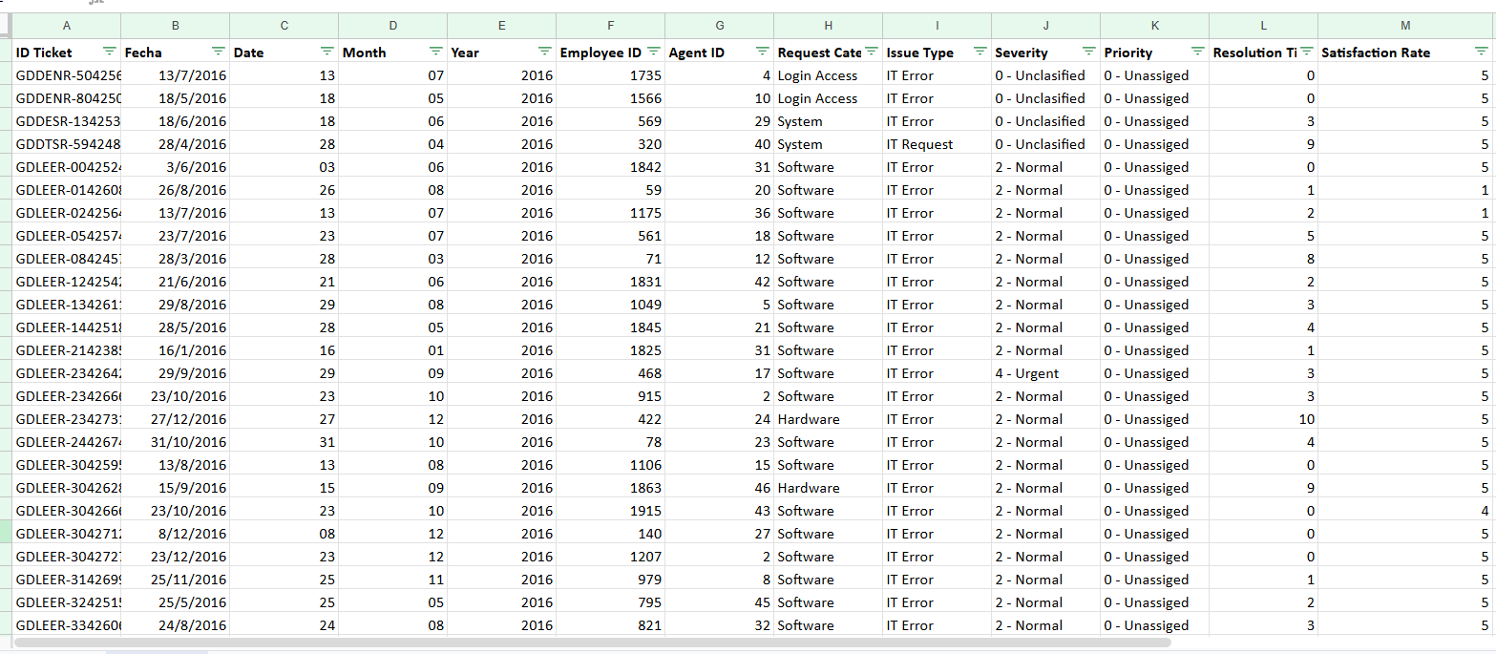
Problem Statement The purpose of this analysis is to evaluate the IT support ticket management system in order to measure agent performance, resolution efficiency, and employee satisfaction levels. The study aims to identify top and underperforming IT agents, examine the overall effectiveness of the support team, and highlight areas where the ticket resolution process can be improved. Ultimately, the objective is to support data-driven staffing decisions—such as hiring, termination, and training—to improve service quality and enhance overall team performance.

Slide 3
Data overview
This analysis is conducted using a dataset of 97,498 IT support tickets obtained from an internal service management system to assess help desk performance and uncover important patterns and trends.
The dataset is organized into two primary files: a Tickets Sheet, which contains detailed records of all support requests, and an IT Agents Sheet, which provides information about the support staff.
Key performance indicators (KPIs) include Resolution Time, with an average of 5 days, and Employee Satisfaction, measured on a scale from 1 to 5.
The help desk handles a steady volume of work, receiving approximately 53 new tickets per day on average.
Each ticket is classified by Request Category (such as Login Access or System), along with Issue Type, Severity, and Priority, enabling a comprehensive analysis of support requirements.
By connecting the ticket records with agent information through the Agent ID, it becomes possible to evaluate performance metrics at the individual agent level, as well as analyze trends based on agent demographics.

Slide 4
Analysis of Ticket Volume (2016-2020)
Key Insights:
The volume of support tickets has steadily increased over the five-year period, rising from 13,051 in 2016 to 29,088 in 2020, which represents more than a twofold growth.
This upward trend is gaining momentum, with the most significant year-over-year increase occurring between 2019 and 2020, indicating a rapidly expanding workload for the support team.

Slide 5
Ticket Distribution by Category
Key Insights:
Approximately 70% of all support tickets are concentrated in just two categories: “System” with 39,002 tickets and “Login Access” with 29,193 tickets, highlighting these as the primary drivers of help desk workload.
In contrast, “Hardware” issues account for only 10% of total tickets, making it the least frequent category. Although less common, hardware-related problems may differ in complexity and could have a distinct impact on resolution time.

Slide 6
Evolution of Customer Satisfaction (2016-2020)
Key Insights:
Service quality has shown consistent improvement over time, with the average customer satisfaction score rising from 3.98 in 2016 to 4.16 in 2020, reflecting a clear positive trend.
This steady increase indicates that initiatives such as enhanced agent training and process optimization have likely contributed to improving users’ overall perception of the support service.

Slide 7
AGENT TICKET VOLUME WITH NAMES
Key Insights:
A significant portion of support tickets—88,656 in total—are categorized as “Normal” severity, representing the routine, everyday workload managed by the IT support team.
Although fewer in number, “Major” (4,836) and “Urgent” (1,392) tickets are the most critical cases. These issues demand prompt and efficient resolution due to their substantial impact on users and overall business operations.

Slide 8
Ticket Distribution by Satisfaction Score
Key Insights:
A substantial share of users express very high satisfaction, with 50,770 tickets earning the top rating of 5, reflecting the team’s strong ability to deliver quality support.
Nevertheless, there is still room for improvement. More than 19,000 tickets received lower ratings (1, 2, or 3), signaling the need to enhance service consistency and investigate the underlying causes of negative feedback.

Slide 9
Average resolution time by request category
Key Insights:
Hardware and Login Access tickets require the most time to resolve. Hardware-related issues have an average resolution time of 7.63 days, while Login Access requests take approximately 6.62 days, making these the most time-intensive categories for the IT support team.
In contrast, System-related requests are resolved remarkably quickly. With an average resolution time of just 0.31 days, System issues are handled far more efficiently than any other category.

Slide 10
Distribution of tickets based on resolution time
Key Insights:
A substantial proportion of tickets are resolved very quickly. The largest share—25,071 tickets—are closed on the same day they are created (0 days resolution time), reflecting strong operational efficiency for a significant portion of support requests.
However, ticket volume decreases sharply as resolution time increases. After the initial few days, the number of open cases drops considerably. This pattern suggests that while most issues are addressed promptly, a smaller group of more complex cases requires significantly longer resolution times.

Slide 11
Age group by satisfaction rate
Key Insights:
The highest satisfaction levels are observed among the youngest and oldest user groups. Employees aged 20–29 report the highest average satisfaction score of 4.23, while those aged 50 and above also show strong satisfaction with a score of 4.16.
In contrast, the middle age groups record comparatively lower satisfaction levels. The 40–49 age group reports the lowest average score of 4.05, indicating that the support experience may not fully meet the expectations of users within this demographic.

Slide 12
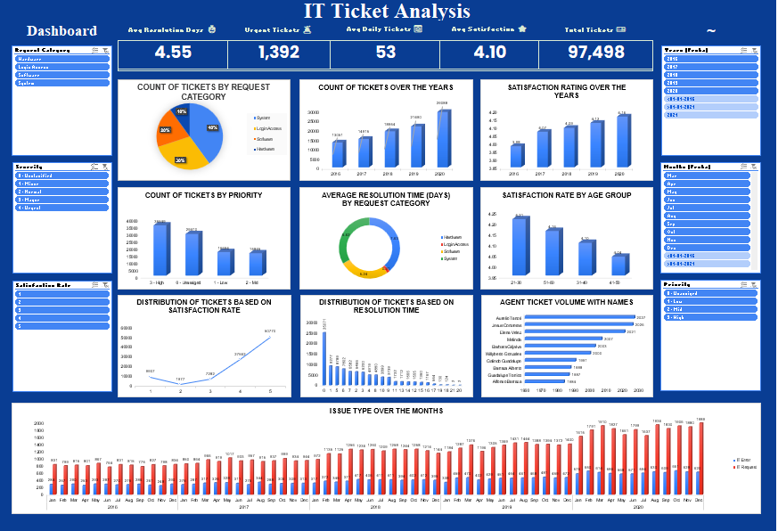

Slide 13
Recommended Action Plan
Primary Recommendation:
Upgrade the Ticket Management System. The existing system lacks efficiency, particularly in managing complex tickets and supporting automation. Implementing a more advanced ticketing solution will serve as the foundation for improving overall service performance and streamlining workflows.
Secondary Recommendations:
1. Automate Login Access Requests: Introduce a self-service password reset system to reduce ticket volume and free up agent capacity for more critical tasks.
2. Implement Specialized Training Programs: Design targeted training sessions focused on handling “System” and “Hardware” issues to improve technical expertise and reduce resolution times for complex cases.

Slide 14
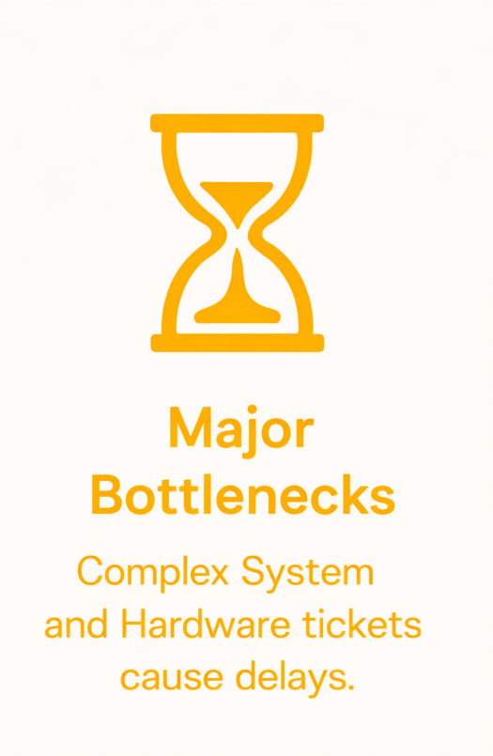
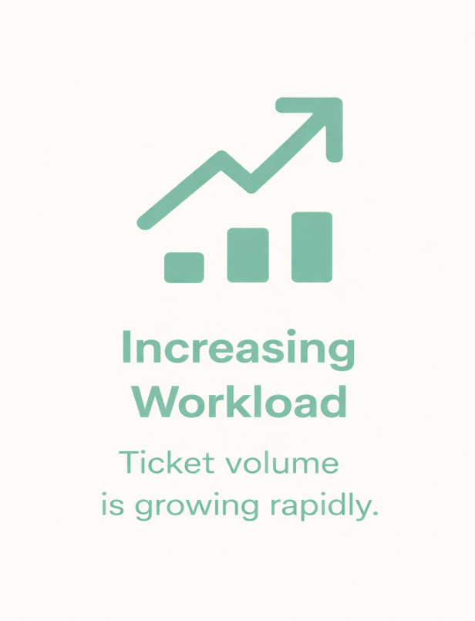
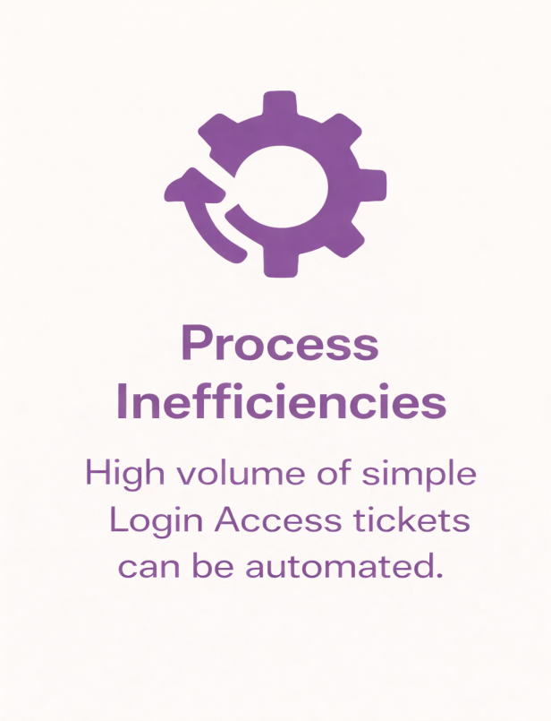
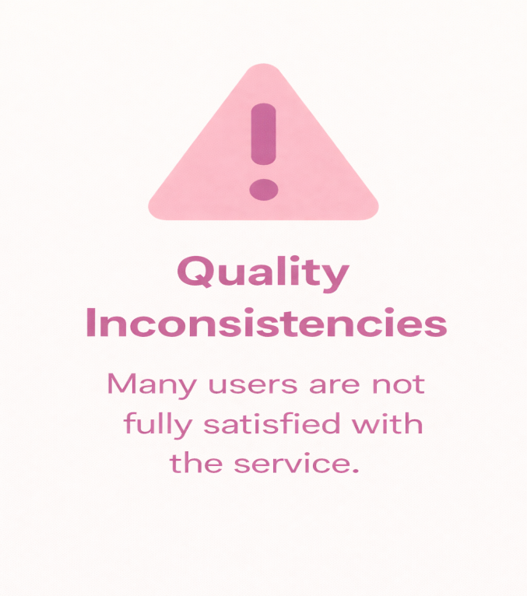
Summary of Key Findings

Slide 15
Conclusion
Key Insights presented step by step:
✅ Step 1: Workload Management
The help desk is effectively managing a rapidly increasing workload. Even though ticket volume has more than doubled over five years, the team maintains strong performance with a high same-day resolution rate and steadily improving satisfaction scores.
✅ Step 2: Service Quality Performance
Overall service quality is strong, with a majority of users giving a 5 out of 5 rating. This indicates that the team is capable of delivering excellent support in most cases.
✅ Step 3: Service Consistency Gap
Despite high overall satisfaction, a noticeable number of tickets receive low ratings. This suggests inconsistency in service delivery and highlights the need to standardize processes.
✅ Step 4: Operational Bottlenecks
Hardware and Login Access tickets take significantly longer to resolve (around 6–8 days on average), making them the primary contributors to delays and reduced efficiency.

